Slide 1
Operating Systems
Semaphores

Slide 2
Semaphores– Software Based Solution
Semaphores proposed by Edsger Dijkstra, is a technique to manage concurrent process by using a simple integer value which is known as Semaphore.
Semaphore is simply a variable which is non-negative and shared between threads.
This variable is used to solve critical section problem to achieve process synchronization in multiprocessing environment.
A semaphore S is a integer variable accessed only through two shared atomic operations wait() and signal().
wait() →P (derived from Dutch word proberen means to test)
signal() →V (derived from verhogen means to increment)

Slide 3
Semaphores
Definition of Wait ()
Wait() operation is used to test if any process is in critical section or not.
P (Semaphore S){ //s is a shared variable
While (S<=0); // s<=0 means already some other process in critical section
// no operation
S--;
}
Definition of Signal()
Used to signal other processes to notify the current executing process is completed and waiting process can use critical section
V (Semaphore S){
S++;
}

Slide 4
Semaphores
Types of Semaphore
Binary Semaphore
Counting Semaphore
Binary Semaphore
The value of binary semaphore can range only between 0 and 1.
On some system binary semaphore are known as mutex locks as they are locks provide mutual exclusion
Example:
Lets assume critical section is free, no processes are executing in critical section.
Initially the value of semaphore s is set to 1

Slide 5
Semaphores
Wait() operation is used to test if any process is in critical section or not.
P (Semaphore S){
While (S<=0);
// no operation
S--;
}
During P1 : initially semaphore value is 1. While loop is false so it breaks out and p1 decrements value of s to 0 and enters into critical section.
During P2: If p2 comes the value of s is 0, while loop is true and it keeps on looping.
Once P1 completes its execution, it will call signal() operation
Signal()
V (Semaphore S){
S++;
}
S is 0 at first but using s++ it will be incremented to 1 by P1.
Immediately after this, S value becomes 1, so P2’s while loop becomes false and it breaks out loop and sets s to 0 and enters critical section.

Slide 6
Semaphores
Counting Semaphore
Its value can range over an unrestricted domain
It is used to control access to resources that has multiple instances
Assume Process has 2 instances so initially the value of S is set to 2. Assume we have 3 processes.
Wait()
P(Semaphore S){
While (S<=0);
S--;
}
Signal()
V(Semaphore S){
S++;
}
P1
S is initially 2
While condition is false
S--- value becomes 1
P2
S is now 1
While condition is false
S--- value becomes 0
P3
S is now 0
While condition is true
Keep on loops
If P1 completes its execution, it activates signal() and increments value of S to 1, so P3 while loop becomes false so P3 can enter critical section

Slide 7
Disadvantage of Semaphores
Main disadvantage of semaphore is busy waiting
While a process in its critical section, any other process that tries to enter its critical section must loop continuously.
Busy waiting wastes CPU cycle that some other process might be able to use.
This type of semaphore is called a spinlock because the process spins while waiting for the lock.
To overcome the need for busy waiting we can modify wait() and signal() operations.

Slide 8
Disadvantage of Semaphores
When a process executes in the wait() operation and finds semaphore value is non positive it must wait.
However rather than engaging busy waiting, the process can block itself.
The block operation places a process into a waiting queue associated with the semaphore and the state of the process is switched to the waiting state.
Therefore CPU becomes available because it is not in busy waiting i.e continuously looping in while loop by wasting CPU.
This CPU usage can be utilized for another process execution.
This will lead to deadlock and starvation.

Slide 9
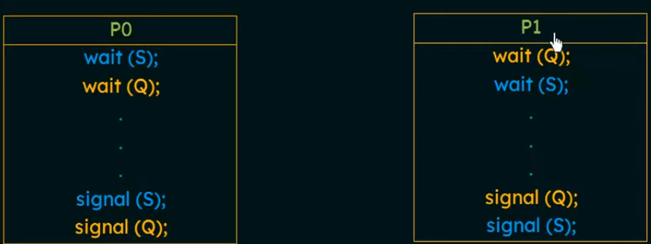
Disadvantage of Semaphores
Deadlocks and Starvation
The implementation of a semaphore with a waiting queue may result in a situation where two or more processes are waiting indefinitely for an event than can be caused by one of the waiting process.

Slide 10
THANK YOU

